Slide 1

Python GUI Calculator using Tkinter
A beginner-friendly desktop application built with Python's Tkinter library for performing basic arithmetic operations
Ruby Sethi

Slide 2
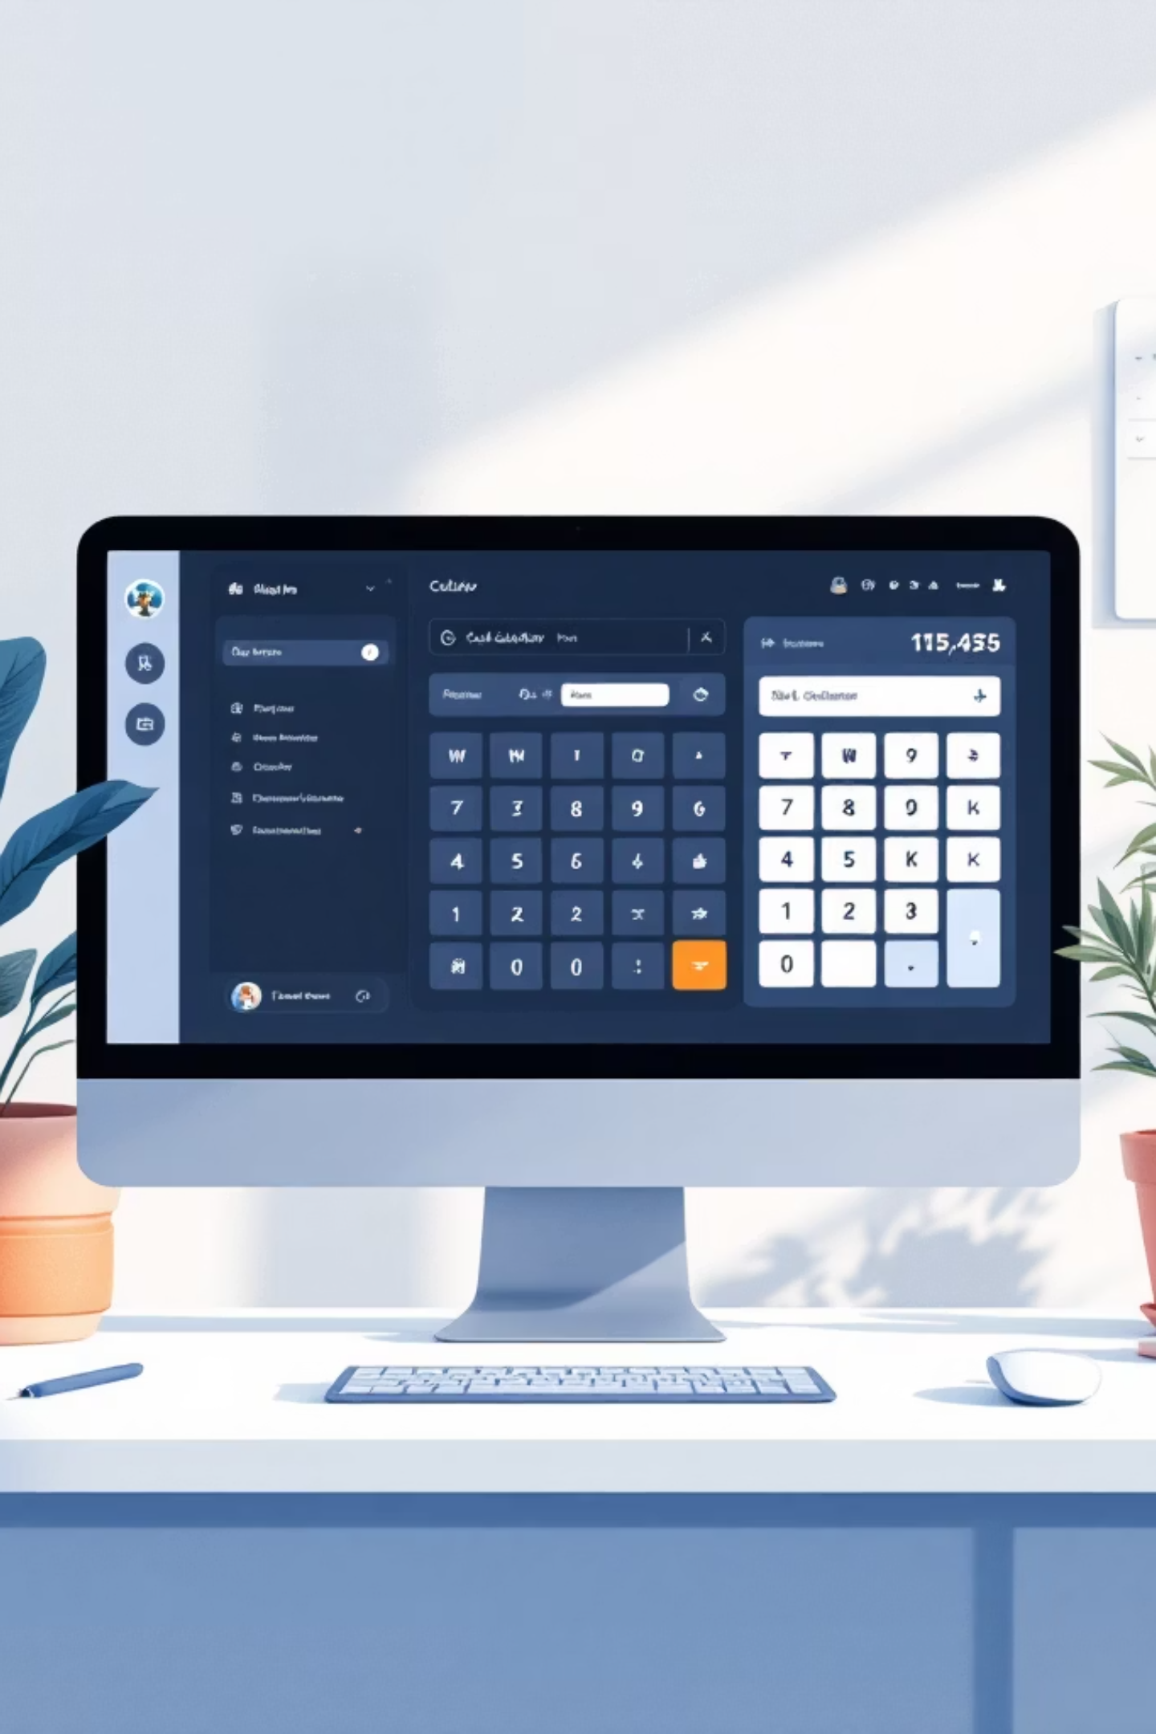
Introduction & Objectives
What is a GUI Calculator?
Project Goals
Build a functional calculator using Python
Master GUI development with Tkinter
Implement core arithmetic operations
Create an intuitive user experience
A graphical user interface application that performs arithmetic operations through button clicks and displays results in a visual interface. Unlike command-line calculators, GUI applications provide intuitive, user-friendly interactions.

Slide 3

Tools & Technologies
Python
Tkinter Library
Primary programming language chosen for its simplicity, readability, and extensive library support for rapid application development
Python's standard GUI toolkit providing widgets, event handling, and cross-platform compatibility for desktop applications
Visual Studio Code
GitHub
Modern code editor with Python extensions, debugging tools, and syntax highlighting for efficient development
Version control system for tracking code changes, collaborating, and maintaining project documentation

Slide 4

What is Tkinter?
Definition
Tkinter is Python's standard GUI library that combines the Tk GUI toolkit with Python bindings. It provides a simple way to create desktop applications with windows, buttons, text fields, and other interactive elements.
Key Features
Pre-installed with Python installation
Cross-platform compatibility (Windows, macOS, Linux)
Rich widget collection for diverse UI needs
Event-driven programming model
Simple syntax for beginners
Why Tkinter?
Tkinter was selected for its beginner-friendly learning curve, minimal setup requirements, and suitability for educational projects. It allows students to focus on programming concepts rather than complex configuration.

Slide 5

Project Overview
Calculator Features
The application provides a clean interface for performing basic arithmetic operations. Users can input numbers through button clicks, chain multiple operations, and clear the display with a dedicated button.
Basic Arithmetic Operations
Clear Functionality
Visual Display
Addition, subtraction, multiplication, and division functions
Reset button to clear current calculations and start fresh
Entry widget shows input numbers and calculation results in real-time

Slide 6





Working of the Project
Button Input
Users click number and operation buttons to build calculations
Display Update
Entry widget updates in real-time to show current input
Operation Processing
Functions evaluate expressions and return results
Result Display
Final calculation appears on screen for user review

Slide 7
Code Explanation
Key Functions
Operation Handling
The calculator uses event-driven programming where button clicks trigger specific functions. Each number button appends its value to the display, while operation buttons store the current value and prepare for the next input.
The equals button evaluates the stored expression using Python's eval() function, which processes the mathematical string and returns the result as a float.
Button Click Logic
Each button is configured with a command that updates the calculator's state. Number buttons add digits to the current expression, while operation buttons store the pending operation.
def button_click(number): current = entry.get() entry.delete(0, END) entry.insert(0, str(current) + str(number)) def button_clear(): entry.delete(0, END) def button_equal(): expression = entry.get() result = eval(expression) entry.delete(0, END) entry.insert(0, result)

Slide 8
Advantages & Limitations
Advantages
Simple, intuitive interface
Beginner-friendly code structure
Lightweight with minimal dependencies
Cross-platform compatibility
Fast execution and response
Limitations
Only basic arithmetic operations
No scientific functions (sin, cos, log)
Minimal error handling
Basic UI design without advanced styling
No keyboard input support

Slide 9
Conclusion & Future Improvements
What Was Achieved
Learning Outcomes
Future Enhancements
This project successfully demonstrates GUI development fundamentals using Tkinter. The calculator implements core arithmetic operations with a functional interface, providing hands-on experience with event-driven programming and widget management.
Understanding of Tkinter widget system
Event handling and callback functions
String manipulation for mathematical expressions
Basic GUI design principles
Add scientific calculator features
Implement theme customization
Add keyboard support for input
Improve error handling and validation
References: Python Official Documentation, Tkinter Documentation, GeeksforGeeks Tkinter Tutorial

